Slide 1
ANJUMAN COLLEGE OF ENGINEERING & TECHNOLOGY
Department of Computer Science & Engineering
SUBJECT : COMPUTER GRAPHICS
5TH SEMESTER
Prepared By:
Ms. Sadia Patka
Asst. Professor, CSE Dept.

Slide 2
SYLLABUS:
Unit 1: Introduction to Computer Graphics Overview of Computer Graphics, Computer Graphics Application and Software, Graphics Areas, Graphics Pipeline, Graphics API’s, Numerical issues, Efficiency Display and Hardcopy Technologies, Display Technologies – Raster scan Display System, Video Controller – Vector scan display system, Random Scan Display Processor, Input Devices for Operator Interaction, Image Scanners
Unit 2: Basic Raster Graphics Algorithms for Drawing 2D primitives, aliasing and ant aliasing, Polygon filling methods: Scan Conversion Algorithms: Simple Ordered edge list, Edge Fill, Fence fill and Edge Flag Algorithm. ,Seed fill Algorithms: Simple and Scan Line Seed Fill Algorithm, Halftoning techniques
Unit 3: Graphics Programming using OPENGL: Why OpenGL, Features in OpenGL, OpenGL operations, Abstractions in OpenGL – GL, GLU & GLUT, 3D viewing pipeline, viewing matrix specifications, a few examples and demos of OpenGL programs, Animations in openGL

Slide 3
Unit 4: 2D Clipping algorithms for regular and irregular windows: Sutherland Cohen Outcode, Sutherland Cohen Subdivision, Mid-Point subdivision, Cyrus Beck and Sutherland Hodgeman, Cohen-Sutherland Polygon clipping Algorithm. Clipping about Concave regions. 2D Transformations, Translation, Rotation, Reflection, Scaling, Shearing Combined Transformation, Rotation and Reflection about an Arbitrary Line
Unit 5: Normalized Device Coordinates and Viewing Transformations, 3D System Basics and 3D Transformations, 3D graphics projections, parallel, perspective, viewing transformations. 3D graphics hidden surfaces and line removal, painter’s algorithm, Z -buffers, Warnock’s algorithm.
Unit 6: Basic Ray tracing Algorithm, Perspective, Computing Viewing Rays, Ray-Object Intersection Shading, A Ray tracing Program, Shadows, Ideal Specular Reflection. Curves and Surfaces: Polygon Mesh, Parametric Cubic Curves, Parametric Bicubic Surfaces, Quadratic Surface, Bezier Curves and B-spline curves.

Slide 4
COURSE OBJECTIVES:
The main objective of the course is to introduce students with fundamental concepts and theory of computer graphics (CG).
It presents the important drawing algorithm, polygon fitting, clipping and 2D transformation curves and an introduction to 3D transformation.
It provides the basics of OpenGL application programming interface which allows students to develop programming skills in CG.

Slide 5
COURSE OUTCOMES:
Upon the completion of the course students will be able to :-
CO1: Explain the applications, areas, and graphic pipeline, display and hardcopy technologies.
CO2: Apply and compare the algorithms for drawing 2D images also explain aliasing, anti aliasing and half toning techniques.
CO3: Discuss OpenGL application programming Interface and apply it for 2D & 3D computer graphics.
CO4: Analyze and apply clipping algorithms and transformation on 2D images.
CO5: Solve the problems on viewing transformations and explain the projection and hidden surface removal algorithms.
CO6: Explain basic ray tracing algorithm, shading, shadows, curves and surfaces and also solve the problems of curves.

Slide 6
Digital Differential Analyzer (DDA)
LINE DRAWING ALGORITHM
WITH SOLVED EXAMPLES

Slide 7
DDA LINE DRAWING ALGORITHM
The line (vector) generation algorithms which determine the pixels that should be turned ON are called as digital differential analyzer (DDA).
It is one of the technique for obtaining a rasterized straight line.
This algorithm can be used to draw the line in all the quadrants.

Slide 8
DDA ALGORITHM
Assumption:
(x1, y1) and (x2, y2) are the two end points of a line and are not equal.
Floor integer function is used to convert the real values into integer value.
e.g.: if value is +8.5 then it is converted to 8 and
if value is -8.5 then it is converted to 9.
3. Sign function is used which returns +1, 0, -1 for the arguments >0, =0, <0.
e.g.: sign(5) = +1 , sign(0) = 0,
sign(-1) = -1, sign (1) = 1

Slide 9
CONTD….
Step 1: Approximate the line length
if abs(x2-x1)>= abs(y2-y1) then
length = abs(x2-x1)
else
length = abs(y2-y1)
end if
Step 2: Decide increment
Δx = (x2-x1) / length
Δy = (y2-y1) / length

Slide 10
CONTD….
Step 3: Decide flow (round the values rather than truncate to handle central pixel addressing correctly)
x = x1 + 0.5 * sign(Δx)
y = y1 + 0.5 * sign(Δy)
Step 4: Begin main loop
i = 1
while (i <= length)
setpixel (intger x, integer y)
x = x + Δx
y = y + Δy
i = i + 1
end while
finish

Slide 11
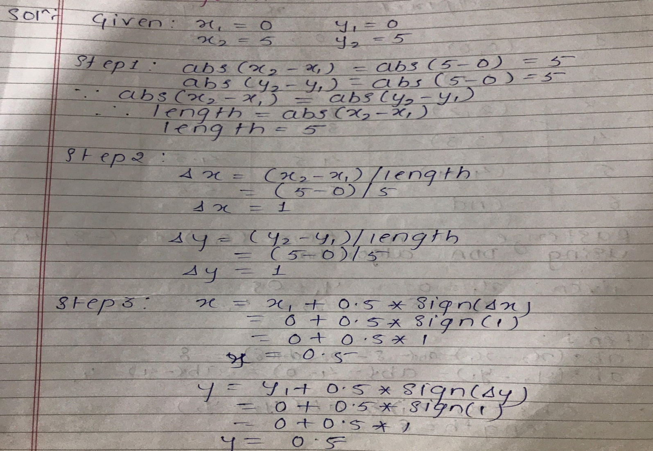
Examples
Q. 1 Rasterize the line from (0, 0) to (5,5) using DDA algorithm.
Solution:

Slide 12
Solution of Q.1 CONTD….

Slide 13
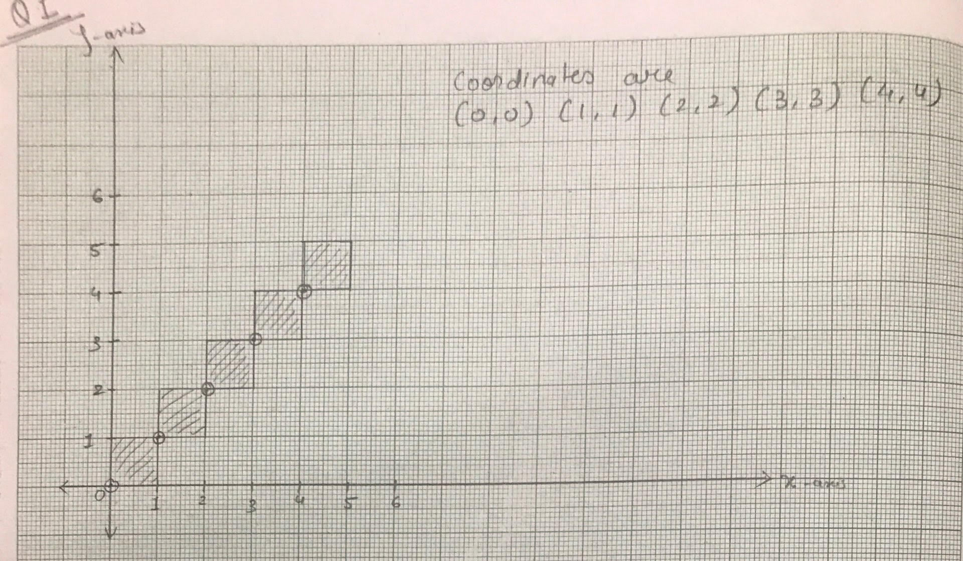
Solution of Q.1 CONTD….
Result :-
The points obtain to rasterize a line from (0, 0) to (5, 5) are :
(0, 0)
(1, 1)
(2, 2)
(3, 3)
(4, 4)

Slide 14
Note
In Question 1, the end points to draw the line are given directly so, the steps of the algorithm are followed to implement it.
But if the end points are not given and instead the equation is given then first we have to find the end points of a line from that equation and then follow the steps of algorithm.
The procedure is demonstrated in Q.2 by solving the question asked in university paper.

Slide 15
Q. 2 Rasterize the line for the equation
x/2 + y/10 = 1 using DDA line algorithm.
Solution: Given is x/2 + y/10 = 1 --------eq. (1)
Put x = 0 in eq. 1 , then y = 10
the 1st end point (x1,y1) is (0,10)
Put y = 0 in eq. 1 , then x = 2
the 2nd end point (x2,y2) is (2,0)
Here,
x1=0 , y1=10 , x2=2 , y2=0

Slide 16
Solution of Q.2 CONTD….
Step 1: abs(x2-x1) = abs(2-0) = 2
abs(y2-y1) = abs(0-10) = 10
Here, abs (y2-y1)> abs(x2-x1)
length =10
Step 2: Δx = (x2-x1) / length = (2-0)/10 = 0.2
Δy = (y2-y1) / length = (0-10)/10 = -1

Slide 17
Solution of Q.2 CONTD….
Step 3: x = x1 + 0.5 * sign(Δx)
x = 0 + 0.5 * sign (0.2)
x = 0 + 0.5 * 1
 x = 0.5
y = y1 + 0.5 * sign(Δy)
y = 10 + 0.5 * sign (-1)
y = 10 + 0.5 * -1
 x = 9.5

Slide 18
Solution of Q.2 CONTD….
Step 4:
i | Set pixel | x | y
1 | (0,9) | 0.5 | 9.5
2 | (0,8) | 0.7 | 8.5
3 | (0,7) | 0.9 | 7.5
4 | (1,6) | 1.1 | 6.5
5 | (1,5) | 1.3 | 5.5
6 | (1,4) | 1.5 | 4.5
7 | (1,3) | 1.7 | 3.5
8 | (1,2) | 1.9 | 2.5
9 | (2,1) | 2.1 | 1.5
10 | (2,0) | 2.3 | 0.5
11 | END | 2.5 | -0.5

Slide 19
Solution of Q.2 CONTD….
Result :-
10
The points obtain to rasterize a line for the equation
x/2 + y/10 = 1 are :
(0,9)
(0,8)
(0,7)
(1,6)
(1,5)
(1,4)
(1,3)
(1,2)
(2,1)
(2,0)
9
8
7
6
5
4
3
2
1
0
1
2
3
4
5
6

Slide 20
Advantages and Disadvantages of DDA
Advantages :
Simplest line drawing algorithm
No special skills required for its implementation
DDA draws the line faster than drawing the line by directly using the line equation.
Disadvantages :
It dependents on orientation which makes the end point accuracy poor.
It requires floating point addition to determine each successive point which is time consuming.
Error due to limited precision in floating point representation may cause calculated points to shift away from their actual position when the line is relatively long.

Slide 21
THANK YOU

